Slide 1
PROGRAMMING TECHNIQUES
Unit - 1

Slide 2
Topics included
Steps Involved in Computer Programming
Problem Definition
Outlining The Solution
Flow Chart
Developing Algorithms
Efficiency of Algorithms
Analysis of Algorithms.

Slide 3
Introduction about Problems

Slide 4
Computers everywhere
Ovens, washing machines and toys
Banks & Hospitals
Transport Reservations, Signaling
Aircraft and industrial plant controllers
Missiles and satellites,
and many more

Slide 5
Why so prevalent
They solve a variety of problems
Efficient maintenance of large no. of data
Precise control of movements
Automation of many boring manual processes In all
They improve the quality of life

Slide 6
Your Job
Many improvements are made and many more to come
You, tomorrow's quality scientists and Engineers, are responsible for this
You need to develop expertise in using computers,
Ability to solve more problems using computers

Slide 7
TOPICS TO BE DISCUSSED:
What is a problem?-Types of problems
Problem Solving in everyday life.
What is Problem solving.
Strategies
Program
Algorithm
Steps involved in problem solving

Slide 8
What is a
PROBLEM
A state of difficulty that needs to be resolved
PROBLEMS EXIST WHERE GOALS NEED TO BE ATTAINED AND THERE IS UNCERTAINTY ABOUT SOLUTION

Slide 9
Problem Faced in Everyday in Life
People make decisions everyday
Examples:
Should I wear casual or formal today?
Should I watch TV or go out to cinema?
what career?
what course?
What shoes?
Everything needs a DECISION AS A SOLUTION TO THE PROBLEM

Slide 10
What happens when bad decisions are made?
WASTAGE OF TIME AND RESOURCES

Slide 11
Problem Solving
Problem solving
The act of finding a solution to a perplexing, distressing, vexing, or unsettled question

Slide 12
Strategies
Ask questions!
  What do I know about the problem?
  What is the information that I have to process in order the find the solution?
  What does the solution look like?
  What sort of special cases exist?
  How will I recognize that I have found
  the solution?

Slide 13
Strategies
Ask questions! Never reinvent the wheel!
Similar problems come up again and again in different guises
A good programmer recognizes a task or subtask that has been solved before and plugs in the solution

Slide 14
Strategies
Divide and Conquer!
Break up a large problem into smaller units and solve each smaller problem
  Applies the concept of abstraction
  The divide-and-conquer approach can be applied over and over again until each subtask is manageable

Slide 15
Program
A set of explicit and unambiguous instructions expressed in a programming language. That set of instructions are called a program.

Slide 16
Algorithms
Algorithm
A set of unambiguous instructions for solving a problem or subproblem in a finite amount of time using a finite amount of data

Slide 17
Six steps to ensure a Best decision in PROBLEM SOLVING
Identify the problem
Understand the problem
Identify alternative ways to solve the problem
List instructions that enable you to solve the problem using selected solution
Select the best way to solve the problem from the list of alternative solutions
Evaluate the solution

Slide 18
Steps Involved in Computer Problem Solving

Slide 19
Computer Problem-Solving
Analysis and Specification Phase
Analyze
Specification
Algorithm Development Phase
Develop algorithm
Test algorithm
Implementation Phase
Code algorithm
Test algorithm
Maintenance Phase
Use
Maintain

Slide 20
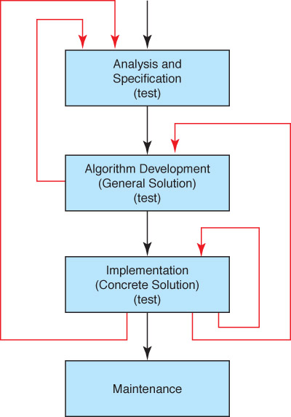
Phase Interactions

Slide 21
ALL THIS SUMMED UP INTO 8 STEPS
Problem definition Analysis and Specification Phase
Outline the solution
Develop the algorithms Algorithm Development Phase
Coding Implementation Phase
Debugging
Testing
Documentation Maintenance Phase
Maintenance

Slide 22
Problem definition
It involves developing the specifications of the problem.
Discuss What is to be done rather than How it is to be done
From the problem statement, we have to extract a set of Precisely defined task.
Specs include:
  Input data
    Type, accuracy, units, range, format, location, sequence
  Special symbols to signal end of data
  Output data (results)
    type, accuracy, units, range, format, location, “headings”
  How is output related to input
  Any special constraint
Example: “find the phone no. of a person” & “Development of algorithm for finding square root

Slide 23
OUTLINE THE SOLUTION
Write down the various steps and explorations made. This is used to systematize our investigations and avoid duplication of efforts
Another step to develop our problem solving skill is once we have solved a problem, to concisely reflect back on the way to discover the solution
The most crucial thing is to practice
A solution is usually composed of many interrelated tasks.
Specify the responsibilities of each task and how they correlate with each other.

Slide 24
Developing an Algorithm
Two methodologies used to develop
computer solutions to a problem
  Top-down design focuses on the tasks to be done
  Object-oriented design focuses on the data involved in the solution

Slide 25
Top-Down Design
Top-Down Design
Problem-solving technique in which the problem is divided
into subproblems; the process is applied to each
subproblem
Modules
Self-contained collection of steps, that solve a problem
or subproblem
Abstract Step
An algorithmic step containing unspecified details
Concrete Step
An algorithmic step in which all details are specified

Slide 26
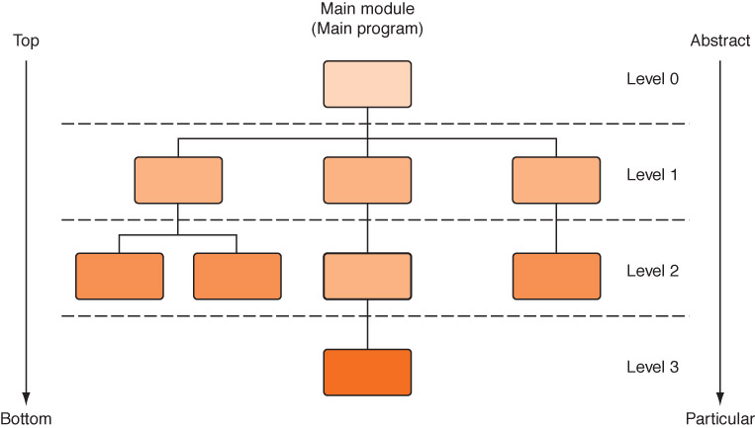
Top-Down Design
Figure 6.5
An example
of top-down design
Process continues for as many levels as it takes to make
every step concrete. Name of (sub)problem at one level
becomes a module at next lower level

Slide 27
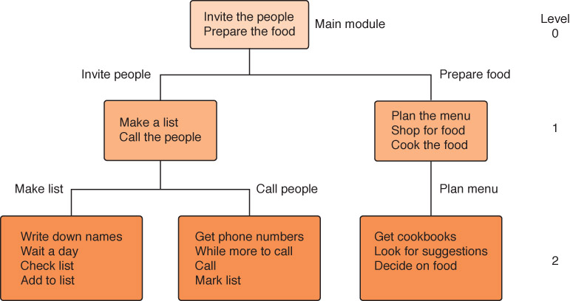
A General Example
Planning a large party
Figure 6.6 Subdividing the party planning

Slide 28
CODING
Algorithm translated into a code using high level language.
The choice depends on the type of the problem
To get the exact result of the problem, proper coding should be written
The codes written should be efficient and concise.
It should be small enough.

Slide 29
DEBUGGING
After the coding part ends, we execute the program to
Discover,
locate and
correct the errors that causes undesired result.
The three types of errors are
Syntax error - grammatical rule violations.
Runtime error - causes errors during execution.
Logical error - faulty logic.

Slide 30
Testing the Algorithm
Important distinction
Mathematics
We tests the answer
Programs
We test the process

Slide 31
TESTING
It should be done to report that whether the problem has met its desired requirements or not.
The process of proving that the program produces correct and meaningful results for all possible data.
It should use the cases that works with all possible pars if the program.

Slide 32
Contd…
There are four test cases,
1.Valid case
Represents data that are logically meaningful and which provides correct results.
2.Boundary case
Represents data that has extremes for valid range or the point at which a decision is made.
3. Special case
Represents data for which normal processing cannot be done.
4.Invalid case
Represents that are meaningless and violate the statements of the problem.

Slide 33
DOCUMENTATION
It is a Continuous process.
Two kinds of documentation
* User level documentation
One needs in order to use the program.
* Technical documentation
It is addressed to the programmer who may modify the program later.

Slide 34
Maintenance
After the documentation gets over, the system should be properly maintained and updated periodically.

Slide 35
Here endS steps in problem solving
End

